Slide 1
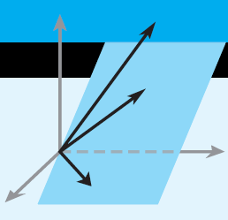
Elementary Linear Algebra
Howard Anton
Copyright © 2010 by John Wiley & Sons, Inc.
All rights reserved.
Chapter 3

Slide 2
Chapter 3
Euclidean Vector Spaces
3.1 Vectors in 2-Space, 3-Space,
and n-Space
3.2 Norm, Dot Product, and Distance in R^{n}
3.3 Orthogonality
3.4 The Geometry of Linear Systems
3.5 Cross Product

Slide 3
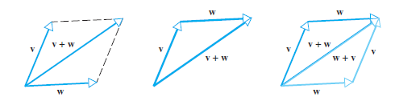
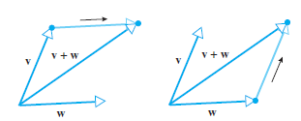
Section 3.1 Vectors
Addition of vectors by the
parallelogram or triangle rules

Slide 4
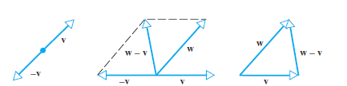
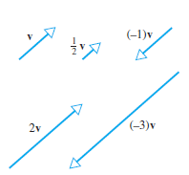
Subtraction:
Scalar
Multiplication:

Slide 5
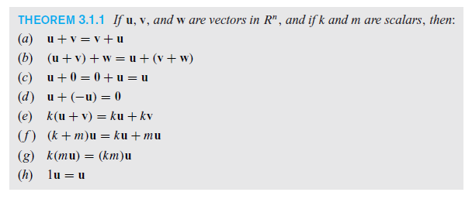
Properties of Vectors

Slide 6
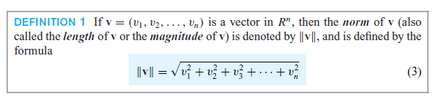

Section 3.2 Norm, Dot Product, and Distance in R^{n}
Norm:
Unit Vectors:

Slide 7
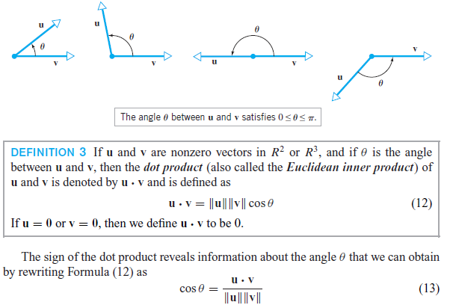
The Dot Product

Slide 8
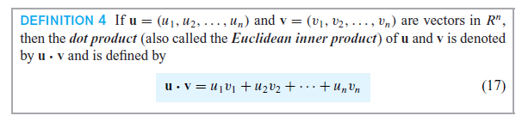
The Dot Product

Slide 9
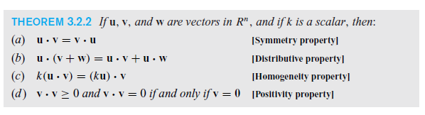
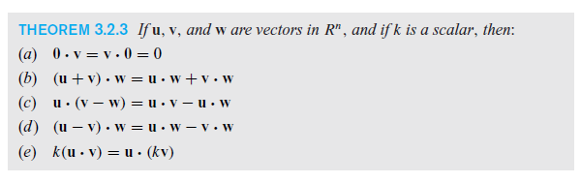
Properties of the Dot Product

Slide 10
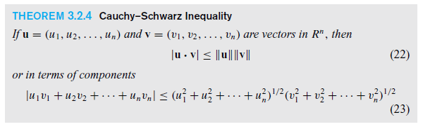
Cauchy-Schwarz Inequality

Slide 11
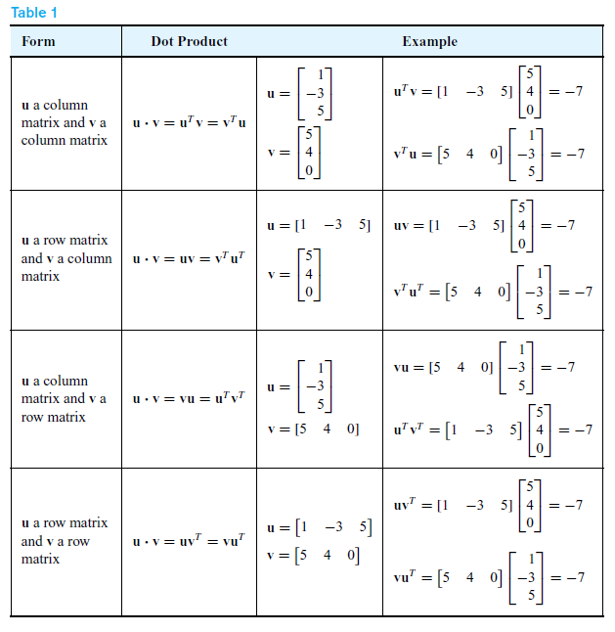
Dot Products and Matrices

Slide 12
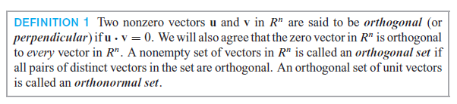
Section 3.3 Orthogonality

Slide 13
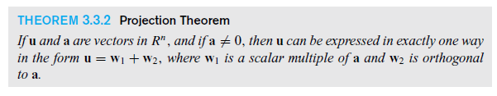

Orthogonal Projections

Slide 14
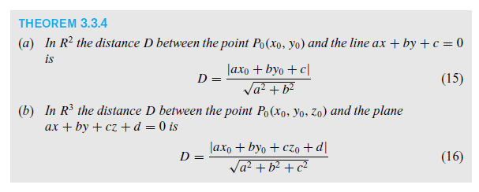
Point-line and point-plane
Distance formulas

Slide 15
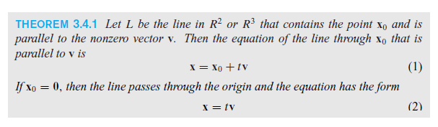
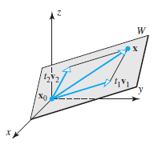
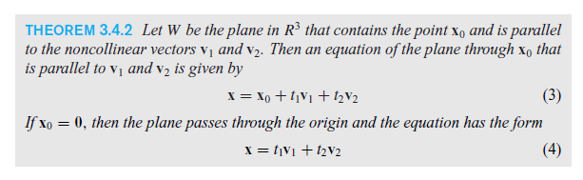
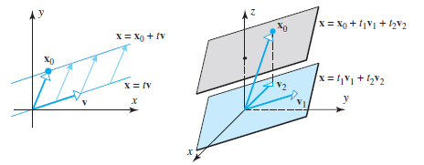
Section 3.4
The Geometry of Linear Systems

Slide 16
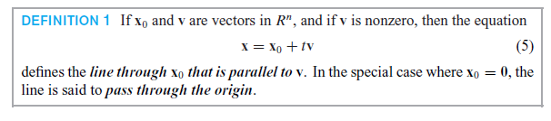
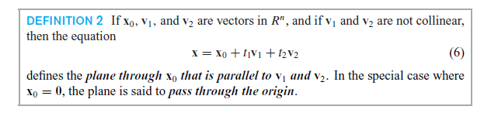

Slide 17
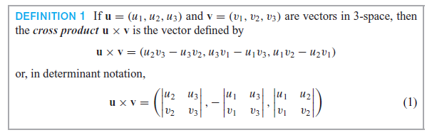
Section 3.5 Cross Product

Slide 18
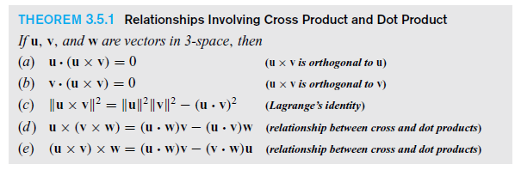
Cross Products and Dot Products

Slide 19
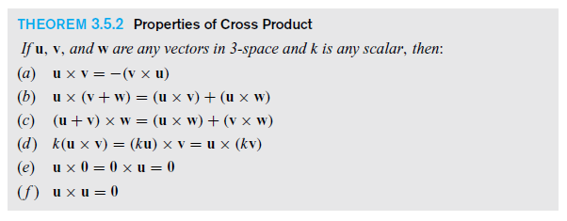
Properties of Cross Product

Slide 20
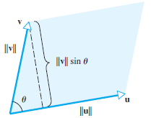

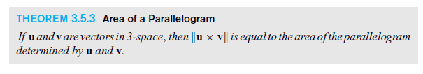
Geometry of the Cross Product

Slide 21
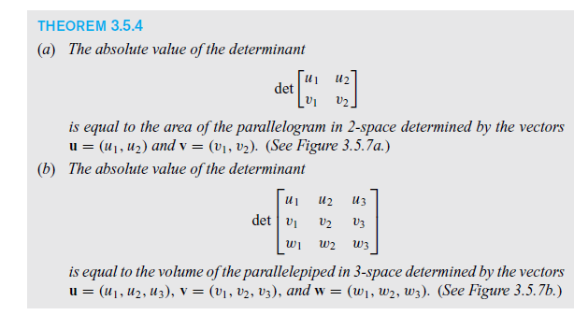
Geometry of Determinants

